Slide 1
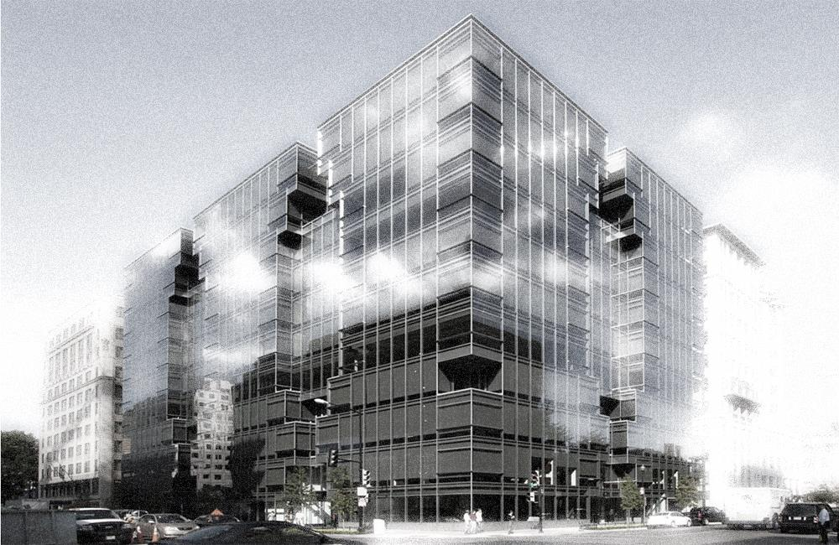



DC’S BUILDING ENERGY PERFORMANCE STANDARDS

Slide 2

BENCHMARKING BASICS
Clean and Affordable Energy Act of 2008 requires all private and DC-owned buildings to report their calendar year (CY) energy and water use to the DOEE for public disclosure by May 1 annually.
Covered Buildings
2010 and on – DC-owned buildings >10,000 sq. ft.
2014 and on – Private buildings > 50,000 sq. ft.
2022 and on – Private buildings > 25,000 sq. ft.
2026 and on – Private buildings > 10,000 sq. ft.
Third Party Data Verification Required
Beginning 2024 and every three (3) years etc.
https://doee.dc.gov/energybenchmarking
@DOEE_DC #BEPSDC
@DOEE_DC #BEPSDC

Slide 3
BUILDING ENERGY PERFORMANCE STANDARD BASICS
Clean Energy DC Omnibus Amendment Act of 2018 requires an establishment of a minimum threshold for energy performance that will be “no lower than” the local median ENERGY STAR score by property type (or equivalent metric).
BEPS 1
BEPS 4
Etc..
BEPS 2
BEPS 3
Standards are set every 6 years (with 1+yr adjustment for COVID in Period 1).
https://doee.dc.gov/service/beps
@DOEE_DC #BEPSDC
@DOEE_DC #BEPSDC

Slide 4

BEPS APPLICABILITY
  As the benchmarking requirements ratchet down in square footage over time, the buildings will be required to meet the BEPS in the following periods until all buildings 10,000 sq. ft. and over are following the performance standards.
BEPS 1:
Private buildings >50,000 sq. ft. and DC-owned >10,000 sq. ft.
BEPS 2:
Private buildings >25,000 sq. ft. and DC-owned >10,000 sq. ft.
BEPS 3:
Private buildings and
DC-owned >10,000 sq. ft.
@DOEE_DC #BEPSDC

Slide 5
BEPS REVOLUTION
Year 1
Year 2
Year 3
Year 4
Year 5
Year 6*
Repeat
Year 7
BEPS Set
Every 6* Years
6-Year Compliance Cycle for Buildings
that do not meet the standard
Data Analysis & Enforcement
3rd Party Data Verification
Every 6 Years
Annual Benchmarking
Annual Benchmarking
Annual Benchmarking
Annual Benchmarking
Annual Benchmarking
Annual Benchmarking
Annual Benchmarking
* COVID-19 PHE adjustment – automatic 1-year delay of BEPS compliance cycle
@DOEE_DC #BEPSDC

Slide 6
ALTERNATIVE COMPLIANCE PAYMENT
Maximum payment based on the gross floor area of the building as reported in the building’s most recent District Benchmark Results and Compliance Report.
Adjusted proportionally based on the actual performance relative to its Pathway target.
EXAMPLE:
  Building A is 100,000 square feet and does not meet the 2021 BEPS
  Maximum payment = 100,000 sf x $10/sf = $1,000,000
  April 1, 2023 - Building A selects the Performance Pathway on April 1, 2023
  April 1, 2027 - Building A reports a Site EUI for CY2026 that is 10% lower than its baseline performance
  Maximum payment adjusted by 50% = $500,000
@DOEE_DC #BEPSDC
@DOEE_DC #BEPSDC

Slide 7
BUILDING ENERGY PERFORMANCE STANDARDS AMENDMENT ACT OF 2024
BEPS Task Force proposed changes to the program where additional flexibility was needed.
Law became effective March 21, 2025. Major changes:
  Financial distress: full exemption for a cycle now available (previously only delayed compliance)
  Changing "penalties" to "payments" – allowing owners to pass through a portion of the cost to non-residential tenants
  Data verification every 6 years instead of 3
  Moving Cycle 2 start from 2027 to 2028
  Requires DOEE to establish a trajectory pathway for Cycle 2
  Etc.
Incorporating Cycle 1 changes into BEPS Guidebook v1.2 – Public comment draft published November 2025
@DOEE_DC #BEPSDC
@DOEE_DC #BEPSDC

Slide 8
BEPS TIMELINE: 2026
Building Owners:
Report CY25 data by 5/1/26
Operation and maintenance, implement any remaining EEMs
Collect evaluation-year data
Third-party verify (3PV) CY26 data
Apply for relief, if applicable:
  Exemption for Financial Distress
  Delay of Compliance
  Pathway Change Application
DOEE:
Publish BEPS Guidebook v1.2
  Exemption for financial distress
Review applications for exemptions, delays, and pathway changes
@DOEE_DC #BEPSDC
@DOEE_DC #BEPSDC

Slide 9
BEPS TIMELINE: 2027
DOEE:
Review reporting and assess BEPS compliance
Collect alternative compliance payments
Develop and set standards for BEPS Period 2 (by 1/1/2028)
Develop BEPS 2 compliance rules, including trajectory pathway
Building Owners:
Finish 3PV of CY26 data
Prepare and submit Completed Actions Report (and any other assigned reporting milestones)
Report CY26 Data
Pay any alternative compliance payments
@DOEE_DC #BEPSDC
@DOEE_DC #BEPSDC

Slide 10
BEPS TIMELINE: 2028 (and beyond…)
Building Owners:
Determine if building meets BEPS 2 (based on CY2026 data)
Report CY2027 data
Select a compliance pathway (by April 1, 2029)
DOEE:
Finalize BEPS 2 rules
  Standards (including 25-50k sqft)
  Compliance Rules, including trajectory pathway
Publish Compliance Cycle 2 Guidebook
Enforcement activities for any buildings with delays of compliance
@DOEE_DC #BEPSDC
@DOEE_DC #BEPSDC

Slide 11

QUESTIONS?
  Contact the Building Performance Division:
  Website: dc.beam-portal.org/helpdesk
  Email: building.performance@dc.gov
  Important Resources:
  Online Guidebook: dc.beam-portal.org/helpdesk/kb/BEPS_Guidebook
  Program Disclosure: www.buildingperformancedc.org

Slide 12
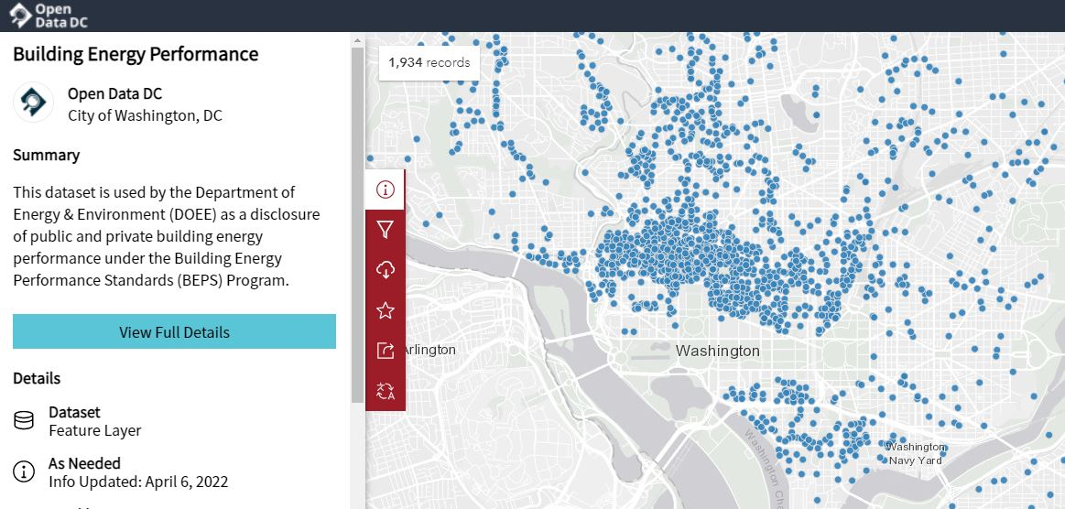
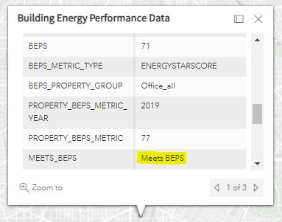
BEPS DISCLOSURE MAP
Disclosure Website: opendata.dc.gov/datasets/building-energy-performance
@DOEE_DC #BEPSDC
@DOEE_DC #BEPSDC

